Slide 1
Applications of Fourier Representations to Mixed Signal Classes and Sampling
SPG

Slide 5
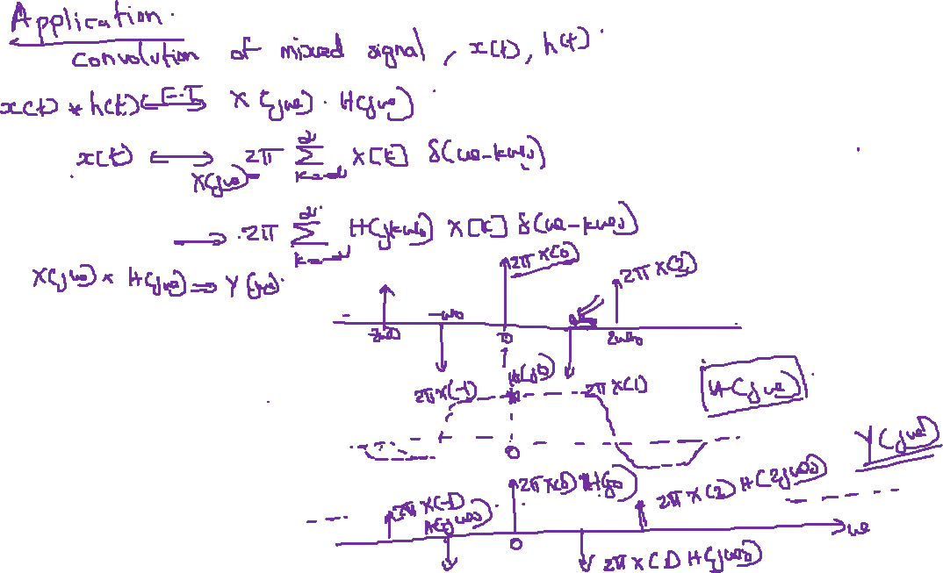

Slide 9
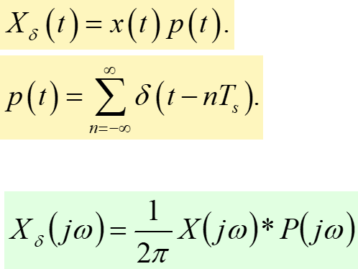

Slide 10
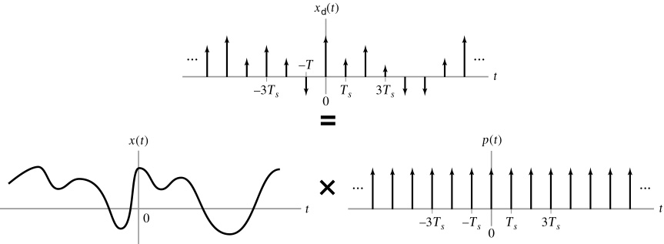

Slide 11
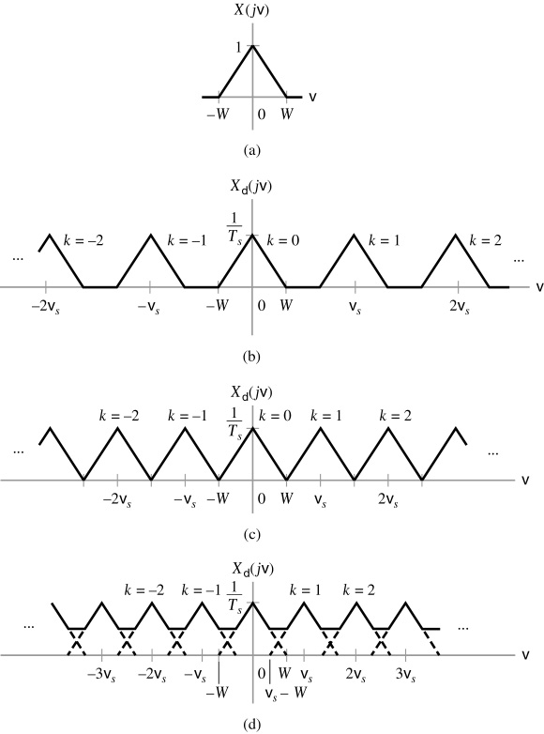
Figure
The FT of a sampled signal for different sampling frequencies. (a) Spectrum of continuous-time signal. (b) Spectrum of sampled signal when ω_{s} = 3W.

Slide 12
Figure
The FT of a sampled signal for different sampling frequencies.
(c) Spectrum of sampled signal when ω_{s} = 2W. (d) Spectrum of sampled signal when ω_{s} = 1.5W.

Slide 13
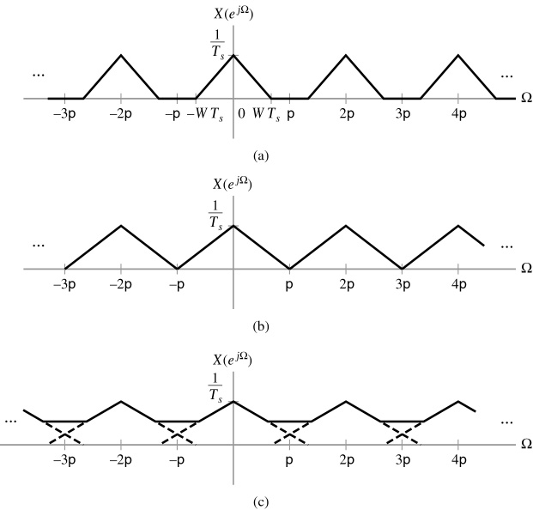
Figure
The DTFTs corresponding to the FTs depicted in Fig. 4-22 (b)-(d). (a) ω_{s} = 3W. (b) ω_{s} = 2W. (c) ω_{s} = 1.5W.

Slide 14
Example

Slide 21
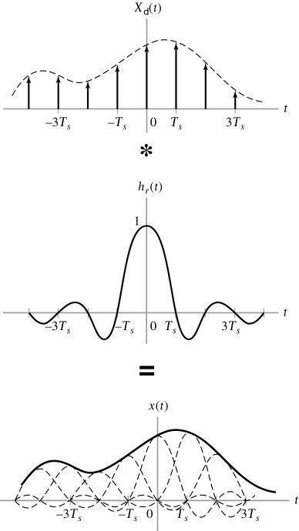
Ideal reconstruction in the time domain.

Slide 22
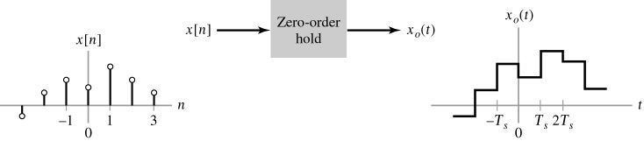
A Practical Reconstruction: The Zero-Order Hold
1. A zero-order hold is a device that simply maintains or holds the value x[n] for
T_{s} seconds
Reconstruction via a zero-order hold.
2. Rectangular pulse:

Slide 24
Thank you

